Slide 1

SREE NARAYANA MANGALAM INSTITUTE OF MANAGEMENT & TECHNOLOGY
MALIANKARA P.O., N. PARAVUR, ERNAKULAM - 683516
DEPARTMENT OF COMPUTER SCIENCE AND ENGINEERING
TRAFFIC SIGN BOARD DETECTION
CSE 2025-2026
Project Team Members
Abil m Abdul Samad -SNM23CS006
Abhinav P S -SNM23CS005
Indrajith P V -SNM23CS026
Abhinand E V -SNM23CS004
Guided By:
Mrs.Asiya U A
Asst. Prof, Dept of CSE

Slide 2
CONTENTS
ABSTRACT
EXISTING SYSTEM PROBLEM STATEMENT HARDWARE REQUIREMENTS SOFTWARE REQUIREMENTS ADVANTAGES
RESULTS ANALYSIS FUTURE SCOPE CONCLUSION REFERENCES

Slide 3
ABSTRACT
Problem Addressed: Drivers often miss or misinterpret traffic signs due to human error, poor visibility, or distraction, leading to accidents.
Core Technology: Uses Convolutional Neural Networks (CNN) and OpenCV for real-time traffic sign detection and classification.
Technical Implementation: A Python-based system processes images from a camera or dataset, applies preprocessing, and uses a trained CNN model for classification.
Primary Application: Real-time traffic sign recognition system for driver assistance and intelligent transportation systems.
Key Benefit: Provides automatic and accurate detection of traffic signs, improving road safety and reducing human dependency.

Slide 4
EXISTING SYSTEM
Manual Observation: Drivers rely on visual observation which can lead to errors.
Basic Camera Systems: Cameras record data but do not provide automated detection or alerts.
Traditional Image Processing: Older methods lack accuracy in complex environments.
No Real-Time Assistance: Existing systems fail to provide instant feedback to drivers.

Slide 5
EXISTING SYSTEM DEMERITS
Human Error: Drivers may miss important traffic signs.
Low Accuracy: Traditional methods fail under poor lighting or weather conditions.
No Automation: Requires manual monitoring.
Limited Scalability: Not suitable for real-time intelligent systems.

Slide 6
PROBLEM STATEMENT
Road accidents often occur due to missed or misinterpreted traffic signs. Existing systems lack real-time detection and accuracy under varying environmental conditions. There is a need for an AI-based system that can automatically detect and classify traffic signs in real time and assist drivers for safer decision-making.

Slide 7
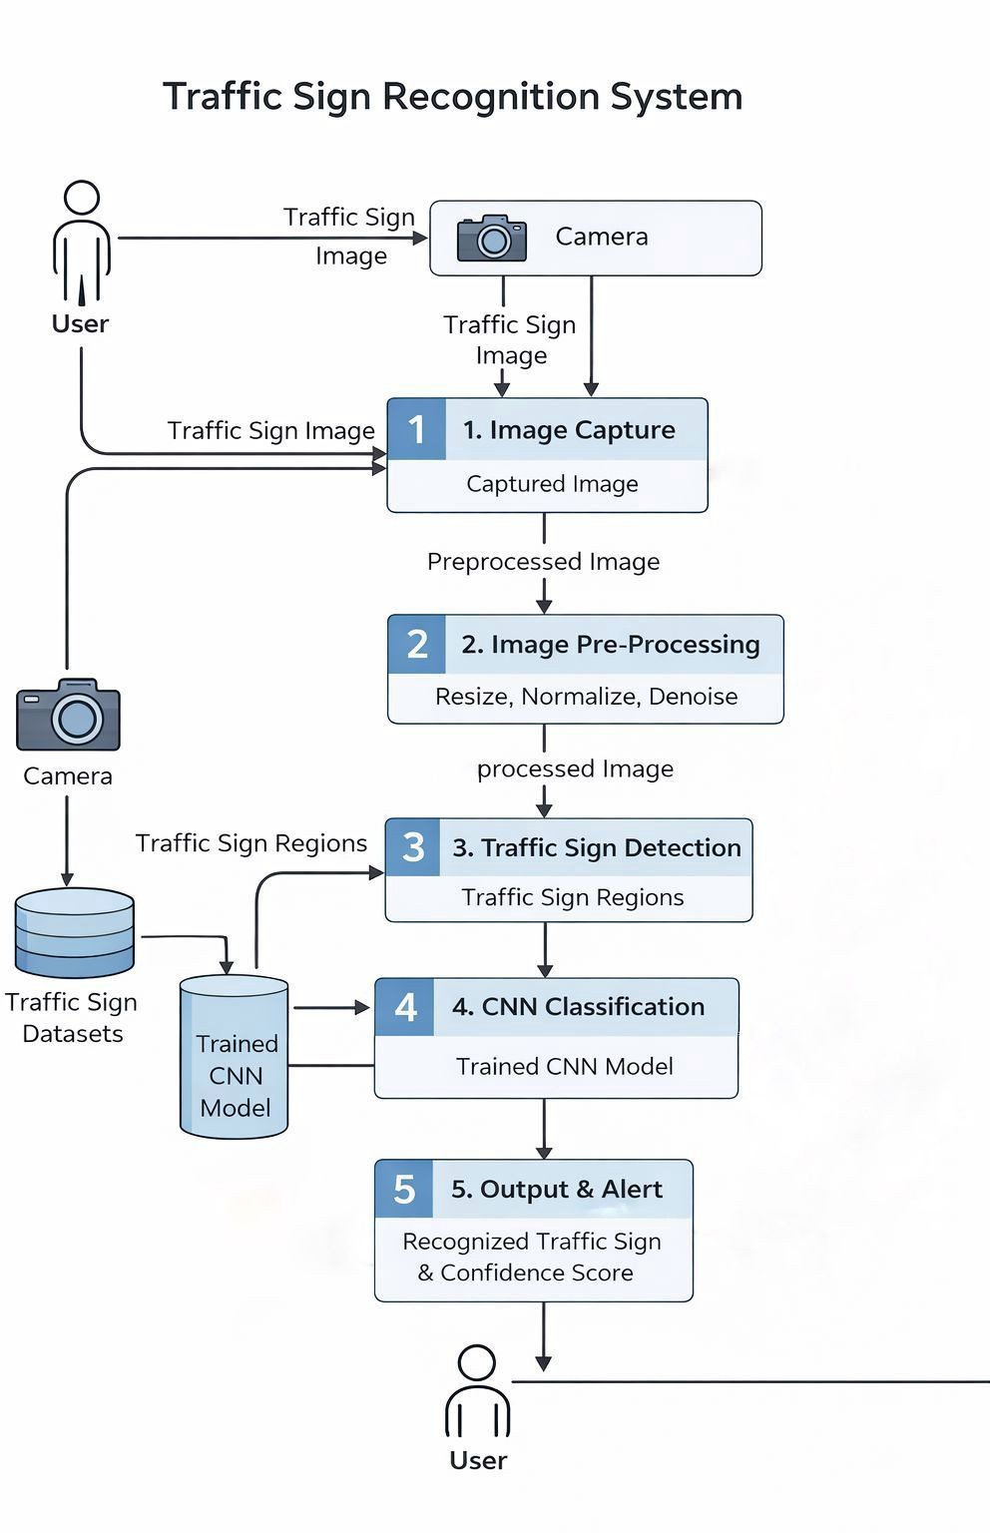
PROPOSED SYSTEM : Architecture

Slide 8
PROPOSED SYSTEM: ALGORITHM
Step 1: Image Capture: The system captures road images using a camera or takes input from a dataset for processing.
Step 2: Image Preprocessing: The captured image is resized to a standard size, normalized, and cleaned by removing noise to improve image quality.
Step 3: Region of Interest (ROI) Detection: The system identifies and extracts the specific area in the image where a traffic sign is likely present.
Step 4: Feature Extraction: Important visual features such as edges, shapes, colors, and patterns are extracted from the detected region using CNN layers.
Step 5: CNN Classification: The extracted features are passed to a trained CNN model, which classifies the traffic sign into predefined categories.
▶ Step 6: Confi
Score Calculation: Tdence
system calculateshe

Slide 9
PROPOSED SYSTEM: DATASET
Traffic Sign Dataset: Uses labeled datasets like GTSRB containing images of real-world traffic signs under different lighting and conditions.
Multiple Categories: Includes different classes such as warning signs, speed limits, prohibition signs, and mandatory signs for better classification coverage.
Training Data: Images used to train the CNN model so it can learn important features like shape, color, and symbols of traffic signs.
Testing Data: Separate set of images used to evaluate the model’s accuracy and ensure it performs well on unseen data.
Data Preprocessing: Images are resized and normalized to maintain uniform input size and improve model performance.

Slide 10
HARDWARE REQUIREMENTS
System Device: Computer or laptop to run the traffic sign detection system and CNN model.
Processor: Intel i5 or above (i7/GPU recommended) for faster image processing and real-time detection.
Memory (RAM): Minimum 8 GB RAM for smooth execution of image processing and deep learning tasks.
Storage Space: 10–20 GB free space for dataset, trained model files, and output results.
Camera: Webcam or mobile camera capable of capturing clear road images (720p or higher recommended).

Slide 11
SOFTWARE REQUIREMENTS
Operating System: Windows 10/11 or Linux (Ubuntu recommended).
Programming Language: Python 3.x for implementation of the system.
Libraries & Frameworks: TensorFlow / Keras for CNN model, OpenCV for image processing, NumPy and Matplotlib for data handling and visualization.
Development Environment: Jupyter Notebook / Google Colab
/ VS Code for coding and testing.
Dataset: Traffic sign dataset (e.g., GTSRB) for training and testing the model.

Slide 12
ADVANTAGES
Real-Time Detection: Continuously detects and recognizes traffic signs from live camera input without delay.
High Accuracy: Uses CNN-based deep learning models to achieve accurate traffic sign classification.
Automatic Recognition: Eliminates the need for manual observation by automatically identifying traffic signs.
Robust Performance: Works under different conditions such as varying lighting, weather, and backgrounds.
Driver Assistance: Provides instant alerts and information to help drivers make safer decisions.
Scalable System: Can be extended for use in autonomous vehicles and advanced driver assistance systems.

Slide 13
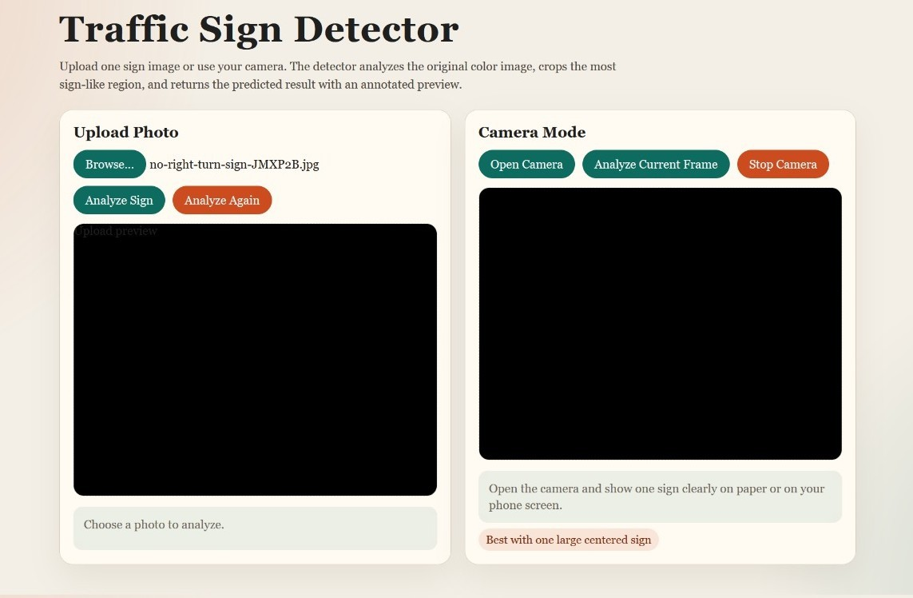
RESULTS : Dashboard

Slide 14
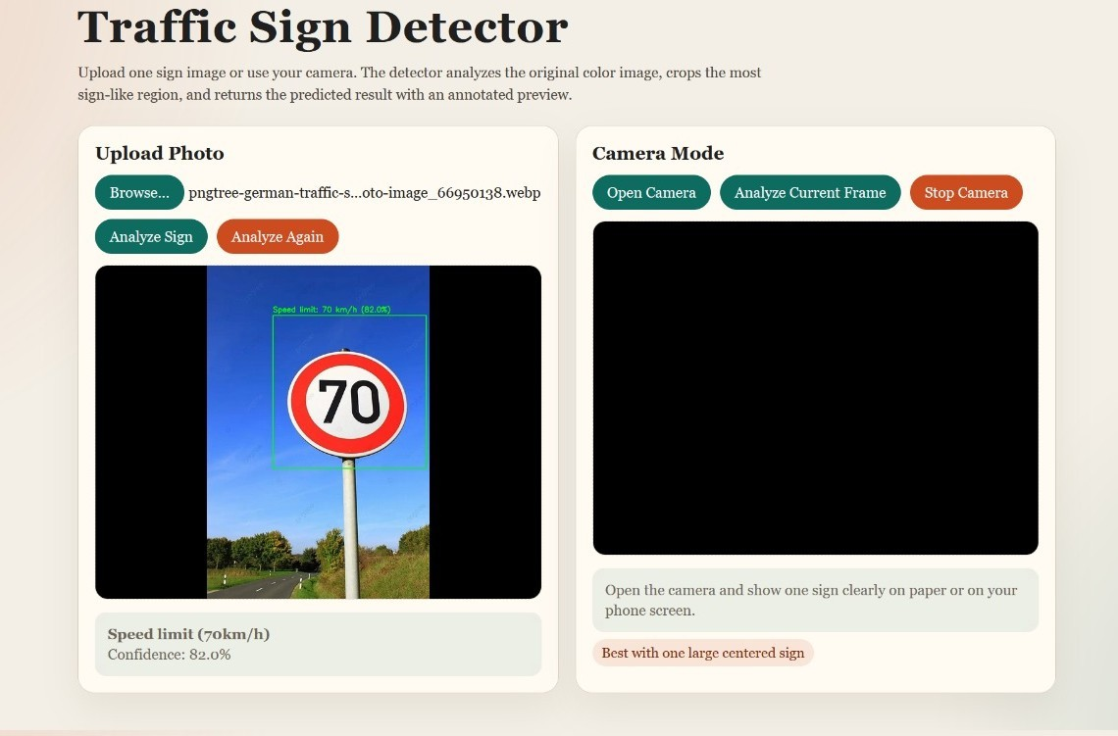
RESULTS : Image Detection

Slide 15
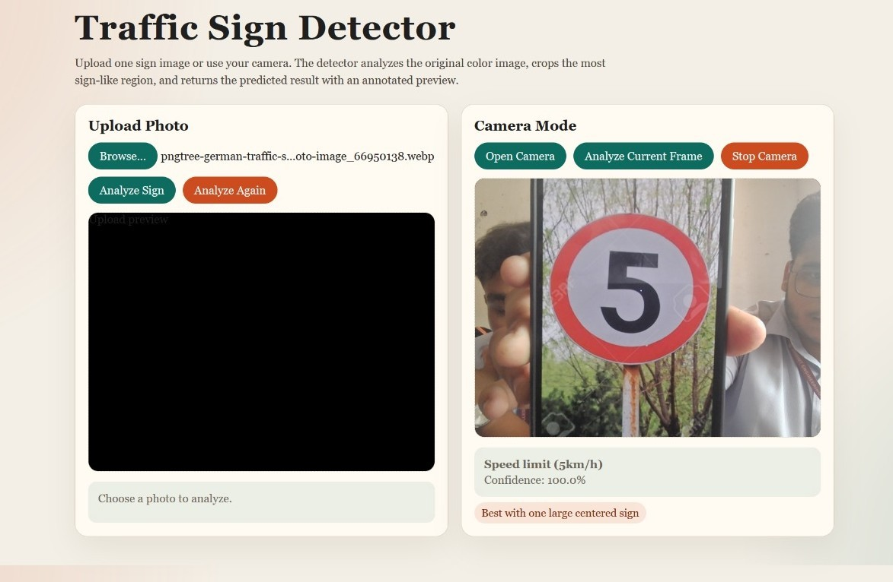
RESULTS : Live Camera Monitoring

Slide 16
Analysis: Accuracy
Formula:
Correct Predictions
Accuracy =
Total Predictions
Calculation:
Correct Predictions = 91 Total Predictions = 100
91
Accuracy = = 0.91
100
Final Result:
Accuracy = 91%

Slide 17
Analysis: Precision
Formula:
Correctly Classified Signs
Precision =
Total Predicted Signs
Calculation:
Correctly Classified Signs = 78 Total Predicted Signs = 85
78
Precision = = 0.918
85
Final Result:
Precision = 91.8%

Slide 18
Analysis: Recall
Formula:
Correctly Classified Signs
Recall =
Total Actual Signs
Calculation:
Correctly Classified Signs = 78 Total Actual Signs = 90
78
Recall = = 0.867
90
Final Result:
Recall = 86.7%

Slide 19
Analysis: F1 Score
Formula:
Precision × Recall
F 1 = 2 ×
Precision + Recall
Calculation:
0.918 × 0.867
F 1 = 2 ×
0.918 + 0.867
F 1 = 0.892
Final Result:
F1 Score = 89.2%

Slide 20
Analysis: Comparison Table
Method | Accuracy
Manual Traffic Sign Recognition | 65%
Traditional Image Processing Methods | 72%
Basic Machine Learning Models | 80%
Standard CNN Models | 85%
Our Traffic Sign Detection System (CNN) | 91%
Table 1: Performance Comparison of Traffic Sign Detection Approaches

Slide 21
FUTURE SCOPE
Advanced Model Improvement: Develop more efficient deep learning models for higher accuracy and faster real-time detection.
Multi-Camera Integration: Extend the system to support multiple cameras for monitoring traffic in different locations simultaneously.
Real-Time Alert System: Implement voice or notification-based alerts to assist drivers instantly.
Mobile Application Integration: Develop a mobile app to display detected traffic signs and alerts in real time.

Slide 22
CONCLUSION
The system successfully detects and classifies traffic signs in real time using CNN-based deep learning techniques.
It improves driver awareness by providing accurate and instant information about road signs.
The system reduces human error and supports safer driving decisions under various conditions.
The model achieved high accuracy in traffic sign recognition, outperforming traditional image processing methods.

Slide 23
REFERENCES
IEEE (2025): Automated Traffic Sign Recognition via CNN Deep Learning – Describes a deep CNN architecture with preprocessing, ROI extraction, and real-time traffic sign recognition.
IEEE (2024): Customized Traffic Sign Detection – Presents an advanced CNN with feature extraction, spatial hierarchy, and context-aware modules for robust traffic sign detection.
IEEE (2024): Traffic Sign Classification for Road Safety using CNN – Explains a five-layer CNN with OpenCV-based image enhancement for accurate traffic sign classification.
IEEE (2023): Traffic Sign Recognition System for Autonomous Vehicles using Deep Learning – Covers CNN-based traffic sign detection and classification, including preprocessing, ROI extraction, and real-time evaluation.

Slide 24
THANK YOU!
Questions?

